Slide 1
Approaches for the Chemical and Consumer Products Industries
George Daston

Slide 2
Many Laws and Regulations!
US
TSCA
FIFRA
FDCA
CPSA
FHSA
EU
REACh
Cosmetics Directive
California
Prop. 65
AB 1879
Japan
Chemical Substances Control Act
Cosmetics Law
Canada
Environmental Protection Act

Slide 3
A few relevant examples
REACh: mandatory registration of chemicals in commerce in Europe
Provides opportunity for read-across, if supported
TSCA: regulates most chemicals in US
Provides some flexibility in data streams
A big criticism has been the difficulty in getting data for most of the 70K chemicals in commerce, and we have seen how ToxCast and ExpoCast can provide some help in prioritizing
EU Cosmetics Directive: amended to prohibit animal testing after March 2013

Slide 4
REACh read-across framework
Six read-across scenarios
Based on two generic hypotheses
Metabolism to a common intermediate
Similar biological activity

Slide 5
Risk Assessment: 21st century version
Predictive toxicology assays
Concentration -response
BPAC
UFs
(Confidence adjust)
TK
variability
BPAD

Slide 6
Risk Assessment by Analogy
Animal Toxicity Data
Dose-response
BMD
UFs
(Confidence adjust)
Chemical similarity
Common metabolism
Common MOA
PK adjust
TK
TD
variability
Acceptable Level
Analog

Slide 7
Predictive Toxicology workflow
exposure
High quality
analogs
Cheminformatics
PK Models
decision
More data
needed
Rapid Lab Methods
Systems biology models

Slide 9
Sixty Years of Toxicology Data
ACToR: aggregator of data on over 500,000 chemicals, 1000 data sources
Number of literature references by endpoint:
Repeat-dose toxicity: 16,000
Carcinogenicity: 15,000
DART: 11,000
Acute tox: 69,000
Data are searchable by chemical structure

Slide 10
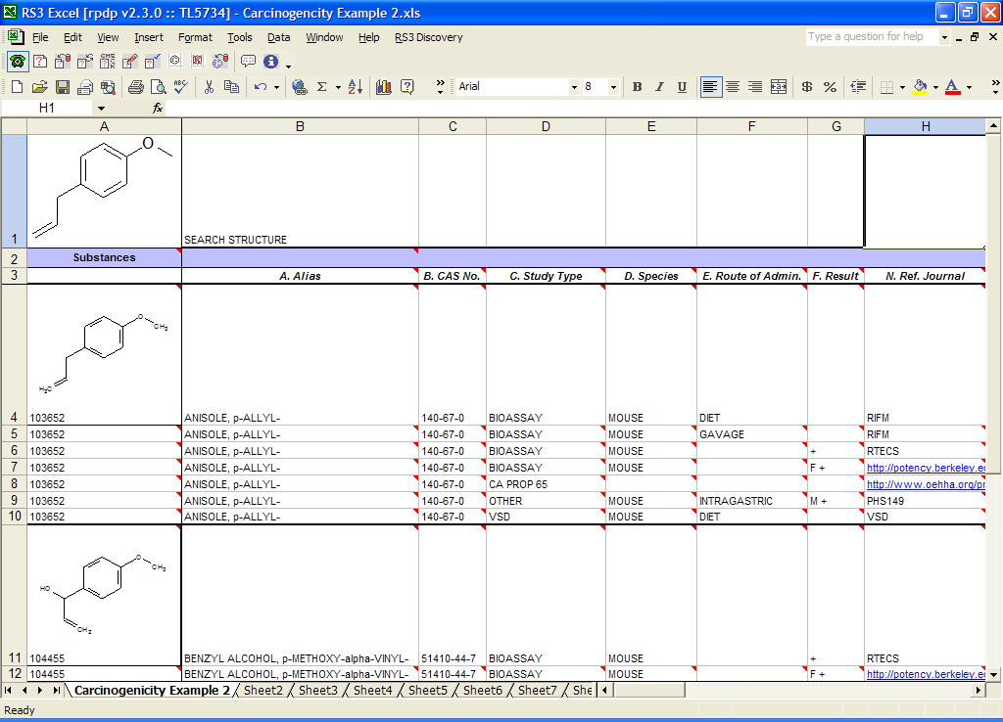
Output – Substructure Searching

Slide 11
Suitable Analogs

Slide 12
Possibly Suitable

Slide 13
Unsuitable Analogs

Slide 14
Organizing Data
Chemical structures associated with specific modes of action
Can be arranged in a decision tree structure to facilitate and enhance search strategies

Slide 15
Expert system decision tree for repro/dev toxicity
Notes:
15

Slide 16
Putative MOA Grouping by Chemical Structure
25 major categories, multiple sub-categories
Highest level of confidence has
Similar structures
Identified molecular target
Similar DART outcome (e.g., common syndrome or highly specific effect)
Along with toxicogenomics, has the potential to accelerate assigning MOA to DART compounds

Slide 17
Outcome of chemistry assessment is hypothesis generation
Chemical is metabolized to a tested analog (or analog and new compound have the same active metabolite)
Currently, assessment is done by wet lab metabolism
Chemical is sufficiently similar in structure to analogs of known toxicity that similar biological activity is inferred
assessment can be done by MOA-specific evaluation, if MOA is known
Global analysis of gene expression
HTS (e.g., ToxCast)
Other methods

Slide 18
Predictive Toxicology workflow
exposure
High quality
analogs
Cheminformatics
PK Models
decision
More data
needed
Rapid Lab Methods
Systems biology models

Slide 19
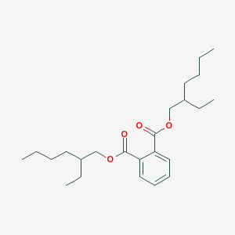
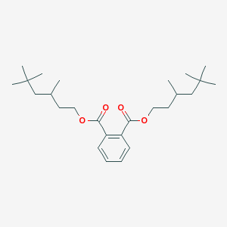
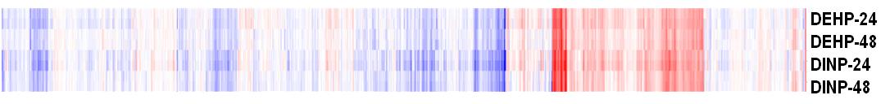
Two Close Structural Analogs
DEHP
DINP
Notes:
19

Slide 20
Connectivity Mapping: High-throughput toxicogenomics
Concept developed by Lamb in 2006
A relatively small number of carefully selected cell types contained all of the pathways necessary to define gene expression profiles for all therapeutic agents in current use
Can we do the same for toxicants?
Cell types: rich in either small molecule receptors or metabolizing enzymes

Slide 21
MOAs to Interrogate with CMAP
Estrogens, environmental estrogens
Anti-estrogens
PPAR agonists
Anti Androgens
Androgens
CAR/PXR agonists
RAR agonists
TR agonists
AhR agonists
Vitamin D agonist
Glucocorticoid receptor agonists
EGFR receptor agonists
FXR receptor agonists
Progesterone receptor agonists
EGFR antagonist
Steroid synthesis inhibitors
HDAC inhibitors
Folate/one-carbon metabolism inhibitor
Glycolytic inhibitors
Oxidative phos/mitochondral inhibitors
Iron chelators
Microtubule inhibitors
Liver cholestasis inducers

Slide 22
Cell Types
Cells enriched for small molecule receptors
MCF-7
Ishikawa
Cells with hepatocyte characteristics
Hep G2
Hepa RG
iCell

Slide 23
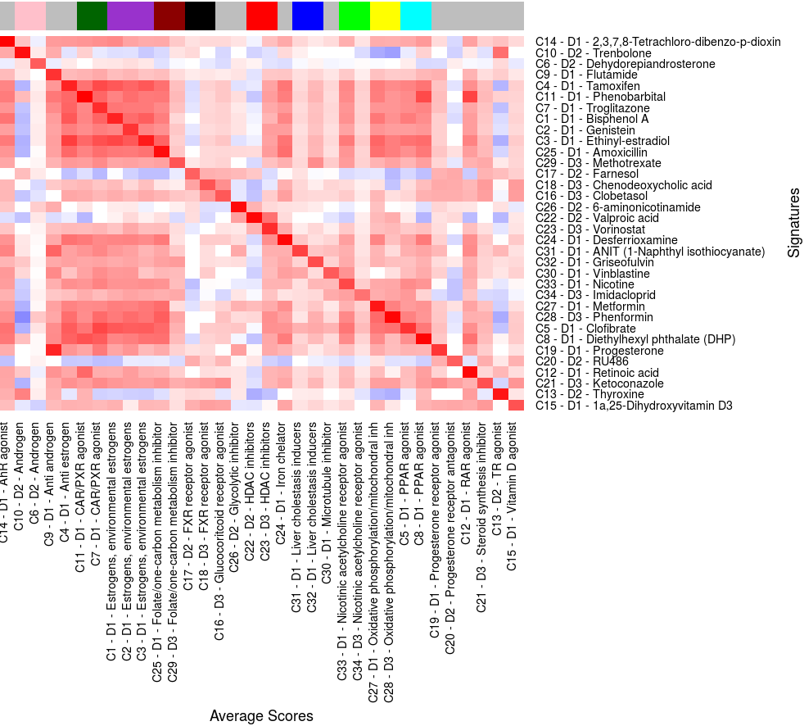

Slide 24
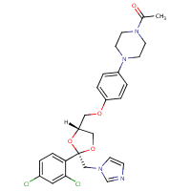
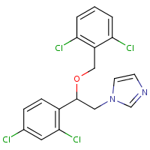
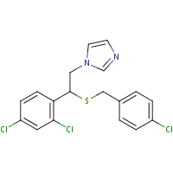
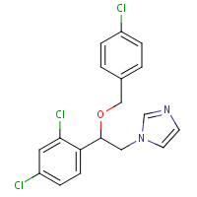
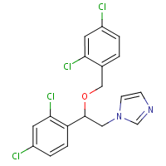
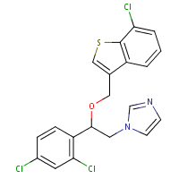
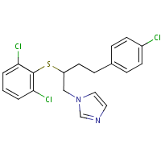
Ketoconazole analogs
ketoconazole
isoconazole
sulconazole
econazole
sertaconazole
butoconazole
miconazole

Slide 25
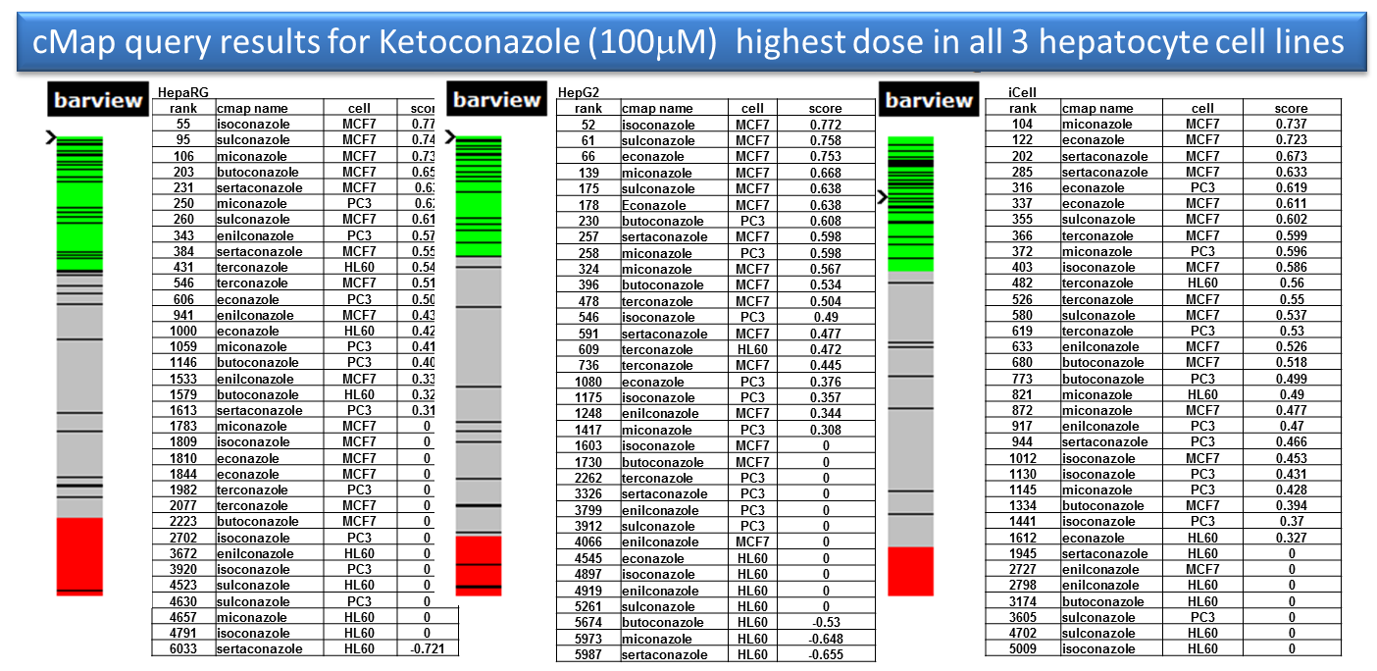

Slide 26
Next steps
More cell types
MCF-7
HepG2
A549
Keratinocytes
Renal epithelium
More chemicals (108 in phase 2)
More modes of action
More analog pairs/ series
More data analysis methods
To optimize the ability to distinguish single MOA from multiple MOA (from non-specific responses)
More focus on concentration-response

Slide 27
Predictive Toxicology workflow
exposure
High quality
analogs
Cheminformatics
PK Models
decision
More data
needed
Rapid Lab Methods
Systems biology models

Slide 28
Estimating internal concentration
Chemical structure
Physiological descriptors and their variability
From literature
Phys-chem property prediction
PBPK
model
From the computer
Metabolism, protein binding data
Partition coefficients for different organs
From the lab

Slide 29
1b face leave on 2x
2
3

Slide 30
Conclusions
Computational methods are available that enable use of the entire toxicology literature to understand the toxicity of untested chemicals
Methods to screen by MOA are available but we need to establish how many MOAs there are
MOA-based screening needs to be connected to adverse outcome
PK methods
Anchoring to analogs
Systems biology models

Slide 31
Acknowledgements
Cheminformatics
Shengde Wu
Karen Blackburn
Jorge Naciff
Joan Fisher
Cathy Lester
Toxicogenomics
Jorge Naciff
Yuching Shan
Xiaohong Wang
Jay Tiesman
Greg Carr
Nadira deAbrew
In silico PBPK
Joanna Jaworska
John Troutman
External
Justin Lamb
Willis Read-Button
Rusty Thomas
Barbara Wetmore
Ed Carney

